Slide 1
https://book.bionumbers.org/
教材的电子版
https://www.weizmann.ac.il/plants/milo/bio-numbers?utm_source=chatgpt.com
课程官网

Slide 2
Sizes Gallery
From:
"Cell Biology by the Numbers"
Ron Milo & Rob Phillips

Slide 3
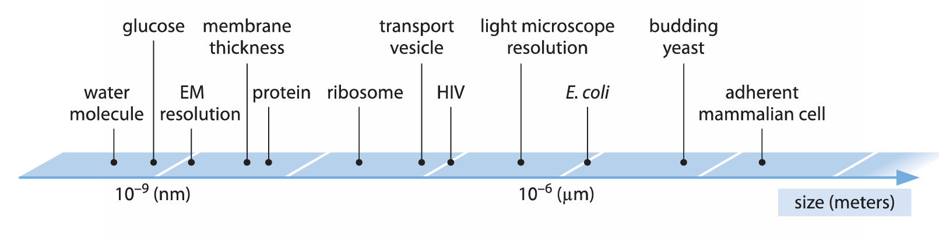
5 order of magnitude in linear size
(i.e. 100,000) span cell biology
Source: Cell Biology by the Numbers (July 2015), p. 30, Fig. 1.

Slide 4
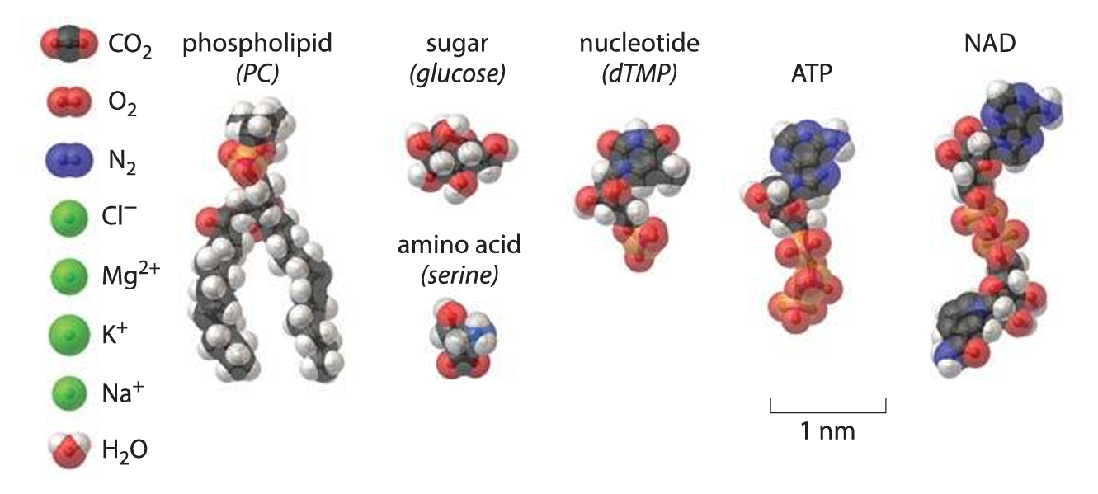
Nuts and bolts
(ions, amino acids, nucleotides)
Source: Cell Biology by the Numbers (July 2015), p. 73, Fig. 1.

Slide 5
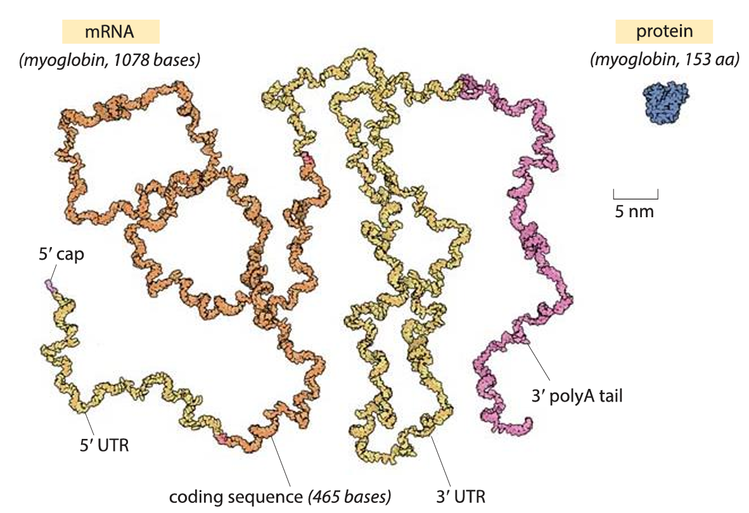
mRNA next to its protein –
blueprint is larger than coded structure
Source: Cell Biology by the Numbers (July 2015), p. 76, Fig. 1.

Slide 6
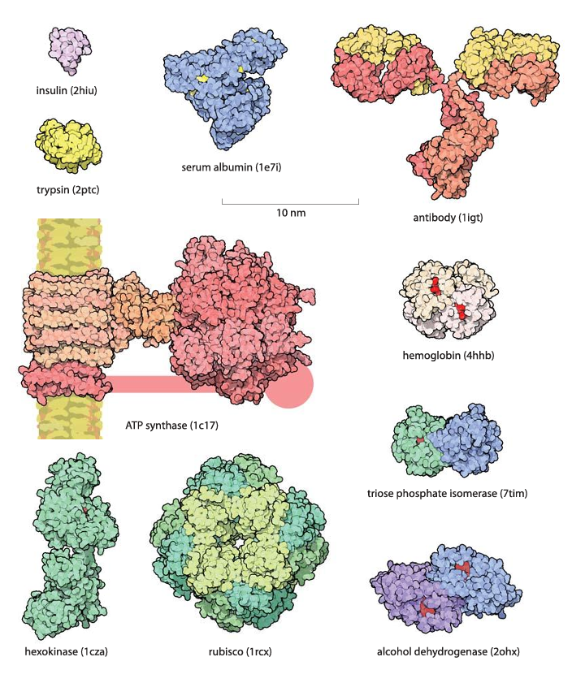
Monomeric
Globular
proteins are
about 5nm in diameter.
Most work in
complexes
Source: Cell Biology by the Numbers (July 2015), p. 79, Fig. 1.

Slide 7
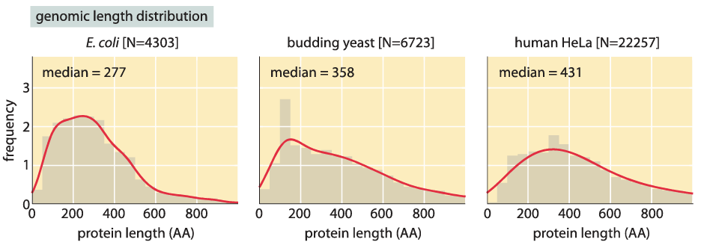
Proteins are usually 200-500 aa long
Source: Cell Biology by the Numbers (July 2015), p. 83, Fig. 3.

Slide 8
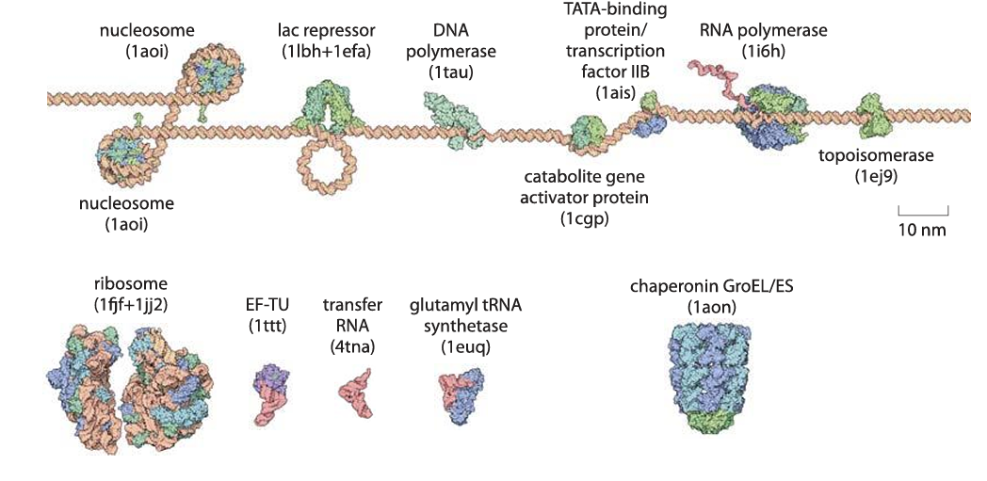
Component of gene expression
Source: Cell Biology by the Numbers (July 2015), p. 85, Fig. 2.

Slide 9
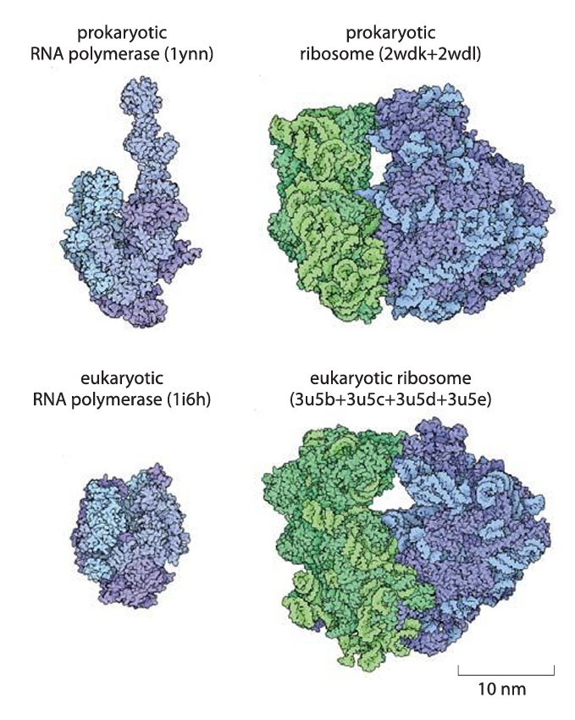
Machines of central dogma
Mega Da mass range
Complexes of tens of proteins.
Ribosome (prokaryotic):
~4000 nucleotides and ~7000 aa
rRNA is ~2/3 of mass in ribosome.
Source: Cell Biology by the Numbers (July 2015), p. 86, Fig. 3.

Slide 10
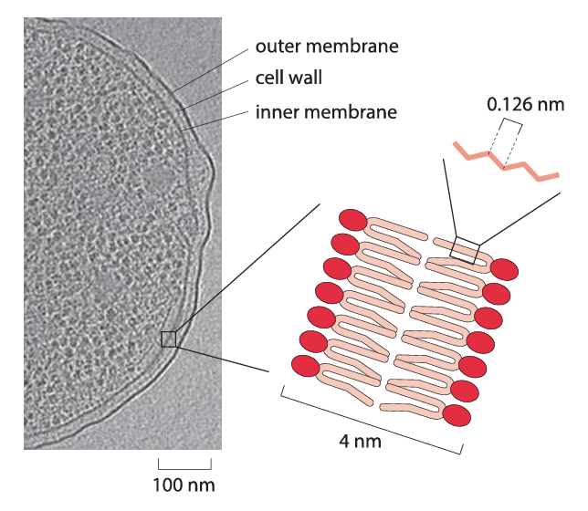
Membranes are about 4nm thick
(without sticking out parts…)
Source: Cell Biology by the Numbers (July 2015), p. 88, Fig. 1.

Slide 11
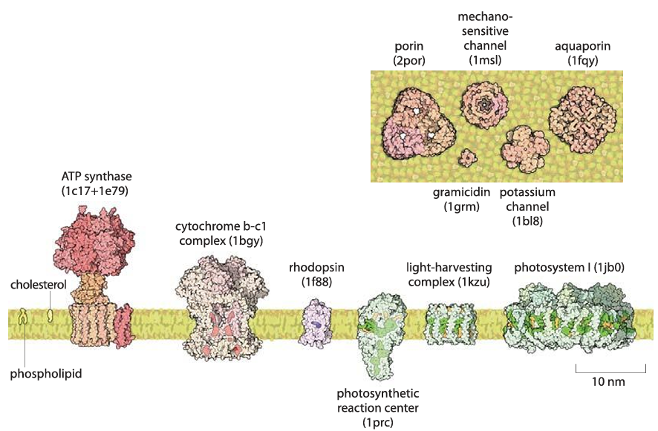
Proteins and membrane are about the same size.
Lots of protein are embedded in the membrane
(about half of mass)
Source: Cell Biology by the Numbers (July 2015), p. 91, Fig. 3.

Slide 12
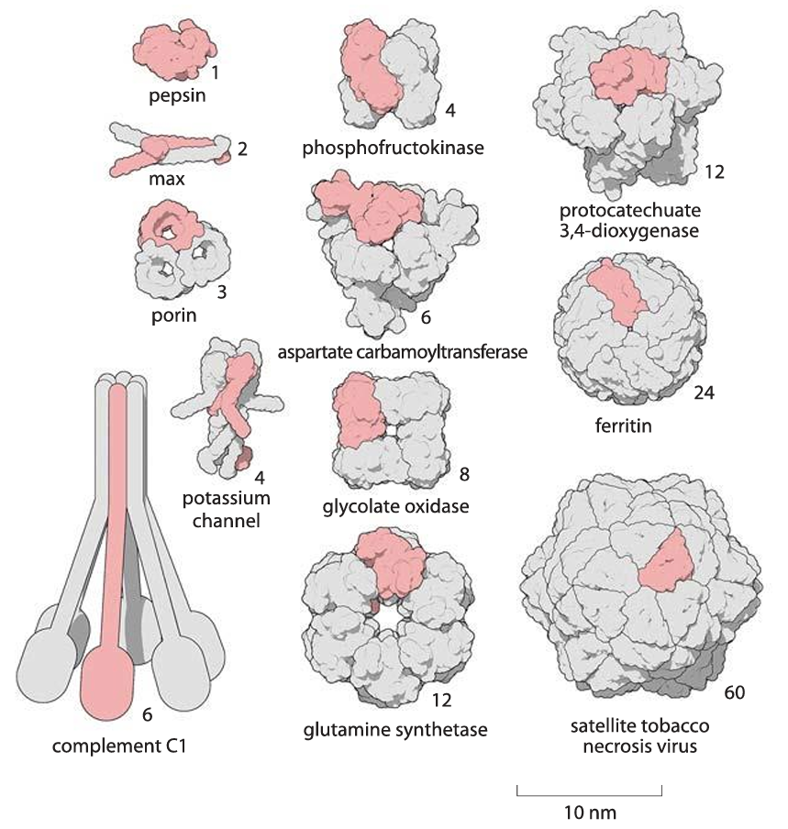
Most protein are usually oligomers
Source: Cell Biology by the Numbers (July 2015), p. 80, Fig. 2.

Slide 13
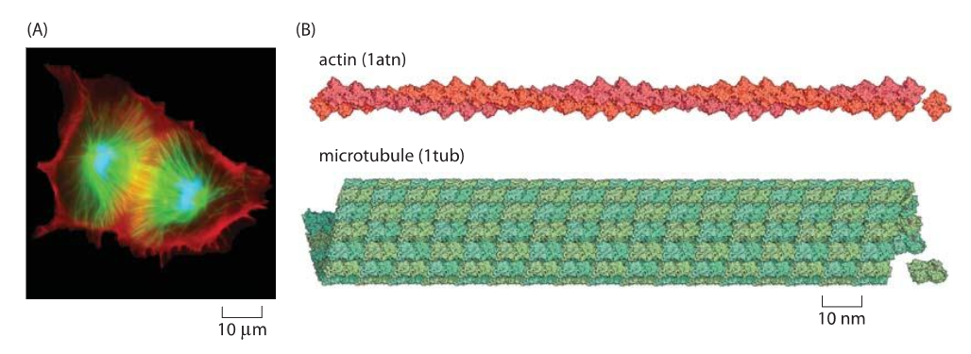
Skeleton of the cell is built of
repeating protein monomers
Source: Cell Biology by the Numbers (July 2015), p. 92, Fig. 1.

Slide 14
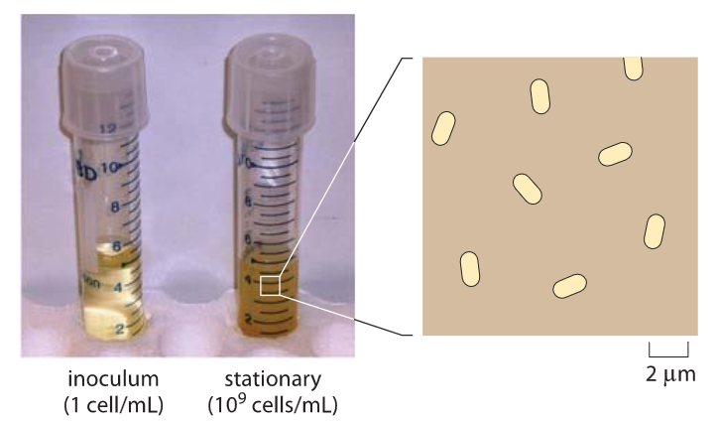
Characteristic density as saturation
(it is hard to realistically show the 3D in 2D)
Source: Cell Biology by the Numbers (July 2015), p. 119, Fig. 1.

Slide 15
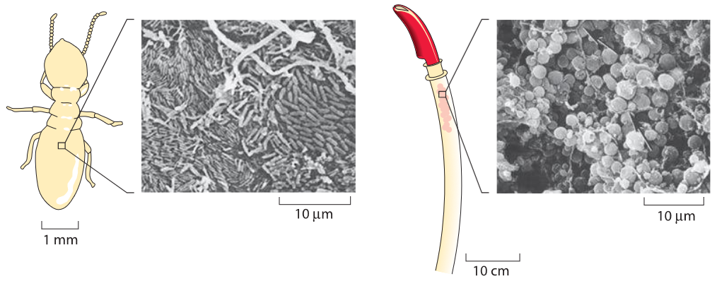
Microbial saturation in nature
Source: Cell Biology by the Numbers (July 2015), p. 120, Fig. 2.

Slide 16
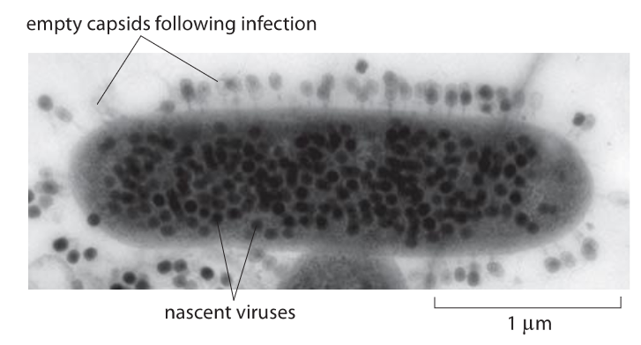
Viruses filing up a bacteria
Transmission electron micrograph of E coli infected with Bacteriophage T4.
Source: Cell Biology by the Numbers (July 2015), p. 388, Fig. 1.

Slide 17
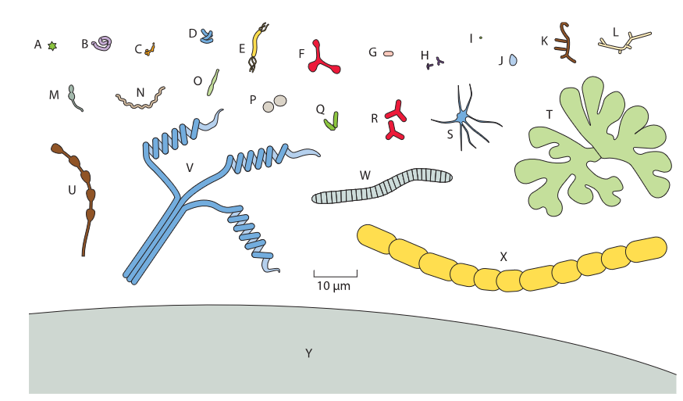
The diversity of bacteria
Figure 1: A gallery of microbial cell shapes. These drawings are based upon microscopy images from the original literature. (A) Stella strain IFAM1312 (380); (B) Microcyclus (a genus since renamed Ancylobacter) flavus (367); (C) Bifidobacterium bifidum; (D) Clostridium cocleatum; (E) Aquaspirillum autotrophicum; (F) Pyroditium abyssi (380); (G) Escherichia coli; (H) Bifidobacteriumsp.; (I) transverse section of ratoon stunt-associated bacterium; (J) Planctomyces sp. (133); (K) Nocardia opaca; (L) Chain of ratoon stunt-associated bacteria; (M) Caulobacter sp. (380); (N Spirochaeta halophila; (O) Prosthecobacter fusiformis; (P) Methanogenium cariaci; (Q) Arthrobacter globiformis growth cycle; (R) gram-negative Alphaproteobacteria from marine sponges (240); (S) Ancalomicrobium sp. (380); (T) Nevskia ramosa (133); (U) Rhodomicrobium vanniellii; (V) Streptomyces sp.; (W) Caryophanon latum; (X) Calothrix sp. (Y) A schematic of part of the giant bacterium Thiomargarita namibiensis (290). All images are drawn to the same scale. (Adapted from K. D. Young, Microbiology & Molecular Bio. Rev., 70:660, 2006.)
Source: Cell Biology by the Numbers (July 2015), p. 51, Fig. 1.

Slide 18
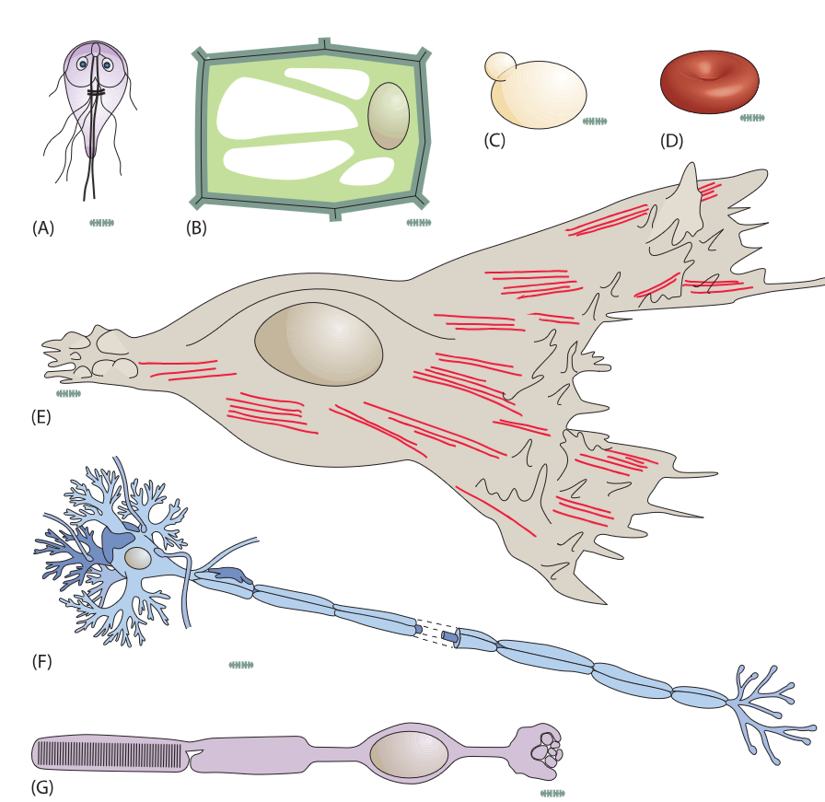
Cartoons of several different types of cells all referenced to a standard E. coli ruler of 1 micron width drawn in grey.
(A) The protist Giardia lamblia, (B) a plant cell, (C) a budding yeastcell, (D) a red blood cell, (E) a fibroblast cell, (F) a eukaryotic nerve cell, and (G) a rod cell from
the retina
Source: Cell Biology by the Numbers (July 2015), p. 54, Fig. 5.

Slide 19

Converting between Daltons and grams
-
+
H atom
Avogadro number
Hydrogen atom mass

Slide 20
Concentrations Gallery
From:
"Cell Biology by the Numbers"
Ron Milo & Rob Phillips

Slide 21
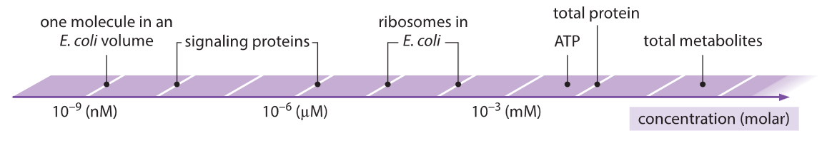
>? orders of magnitude span in concentrations
in a bacterial cell ?
?
?
?

Slide 22
>8 orders of magnitude span in concentrations
(i.e. 100,000,000) in a bacterial cell
Source: Cell Biology by the Numbers (July 2015), p. 101, Fig. 1.

Slide 23
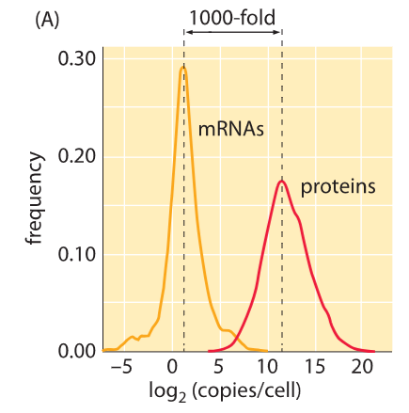
What is the ratio of protein to mRNA?
?
Source: Cell Biology by the Numbers (July 2015), p. 165, Fig. 1.

Slide 24
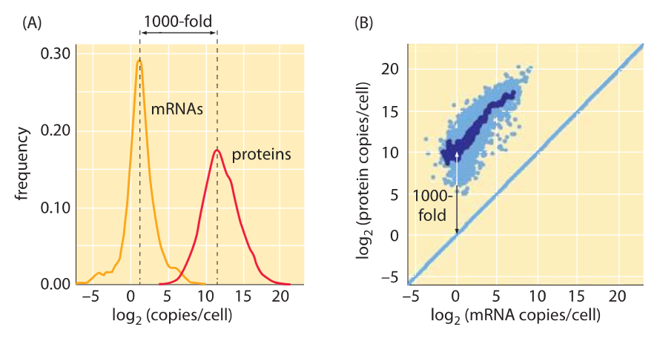
~1:1000 for yeast (here), bacteria and mammalian cells
Source: Cell Biology by the Numbers (July 2015), p. 165, Fig. 1.

Slide 25
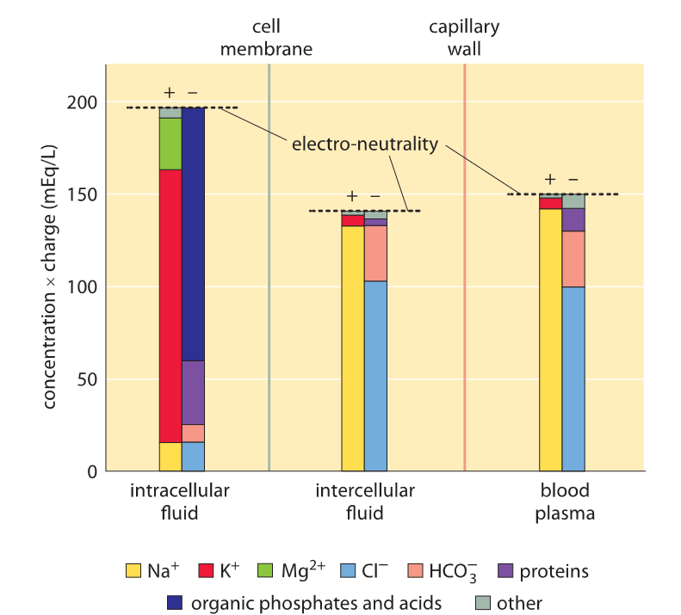
Cells are electroneutral
Source: Cell Biology by the Numbers (July 2015), p. 130, Fig. 1.

Slide 26
Ionic composition of cells
· Na⁺
· K⁺
· Cl⁻
?
?
?
Source: Cell Biology by the Numbers (July 2015), p. 130, Fig. 1.

Slide 27
Ionic composition of cells
Source: Cell Biology by the Numbers (July 2015), p. 130, Fig. 1.

Slide 28
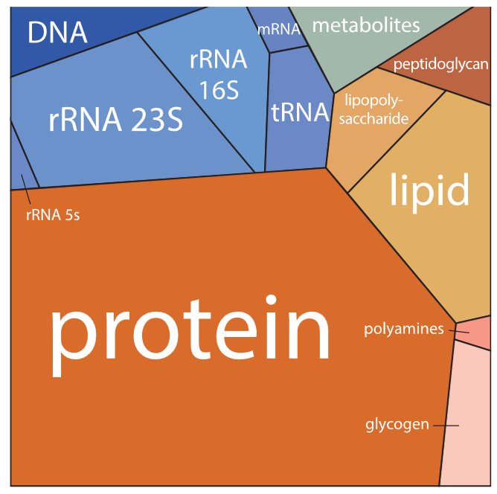
Where cell resources are invested
(biomass, nutrients, production machinery, cell volume)
· DNA
· mRNA
· tRNA
· rRNA 23s
· rRNA 16s
· rRNA 5s
· Protein
· Lipids
· Metabolites
· Peptidoglycan
· Lipopolysaccharide
· Polyamines
· Glycogen
Source: Neidhardt et al, 1999.

Slide 29
Where cell resources are invested
(biomass, nutrients, production machinery, cell volume)
Source: Neidhardt et al, 1999.

Slide 30
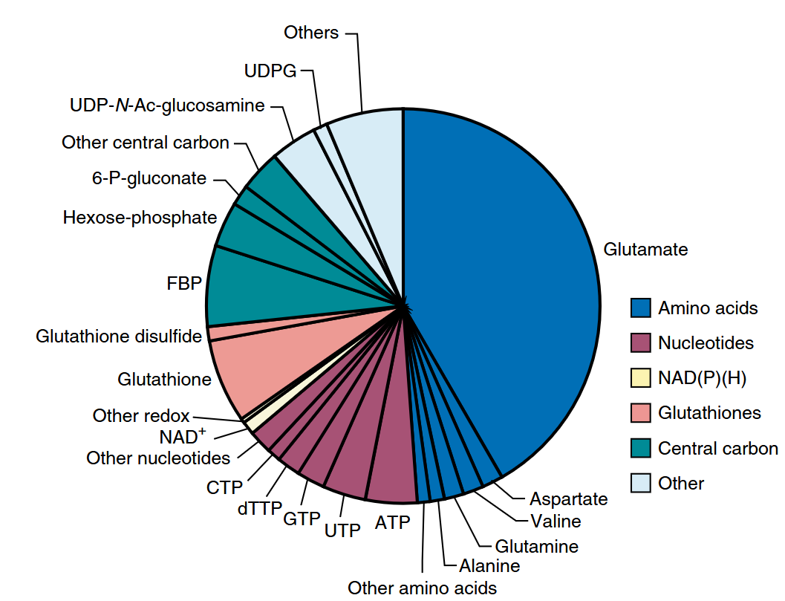
The bacterial cell metabolome is
dominated by a few components
Sum of concentrations ≈ 200 mM
Bennett, B., Kimball, E., Gao, M. et al. Absolute metabolite concentrations and implied enzyme active site occupancy in Escherichia coli.
Nat Chem Biol 5, 593–599 (2009). https://doi.org/10.1038/nchembio.186

Slide 31
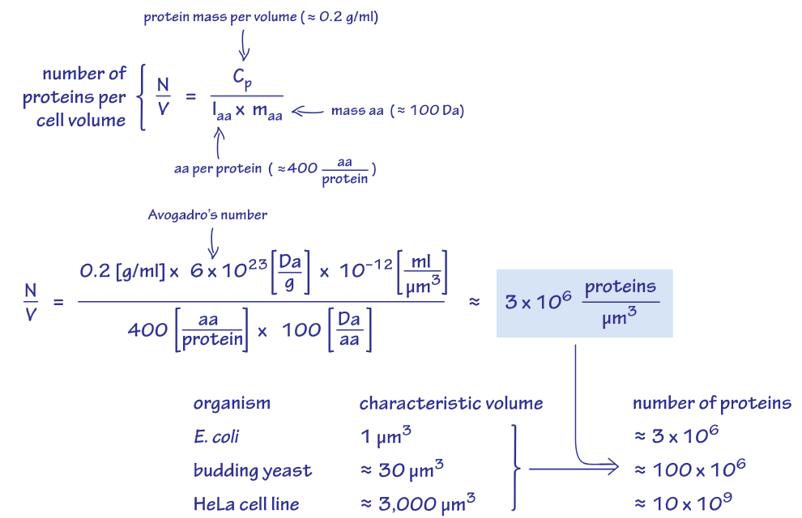
Estimating the number of protein per cell volume
Source: Cell Biology by the Numbers (July 2015), p. 144, Fig. 1.

Slide 32
What are the functions that require the
most protein investment in a cell?
What are the “top 10” most highly
expressed proteins?

Slide 33
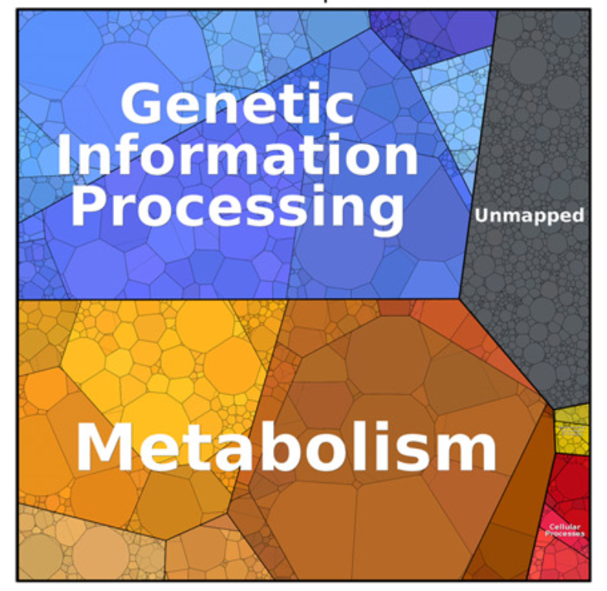
Proteomaps enable quantitative
visualization at the functional level
?
· Metabolism
· Signaling
· Genetic information
processing
?
?
S. Cerevisiae proteome in rich medium
W. Liebermeister et al., 2014.

Slide 34
Proteomaps enable quantitative
visualization at the functional level
· Metabolism and the
Central dogma
dominate the
investment in single-cell organisms
· Signaling (yellow-green) is a minor fraction
S. Cerevisiae proteome in rich medium
W. Liebermeister et al., 2014.

Slide 35
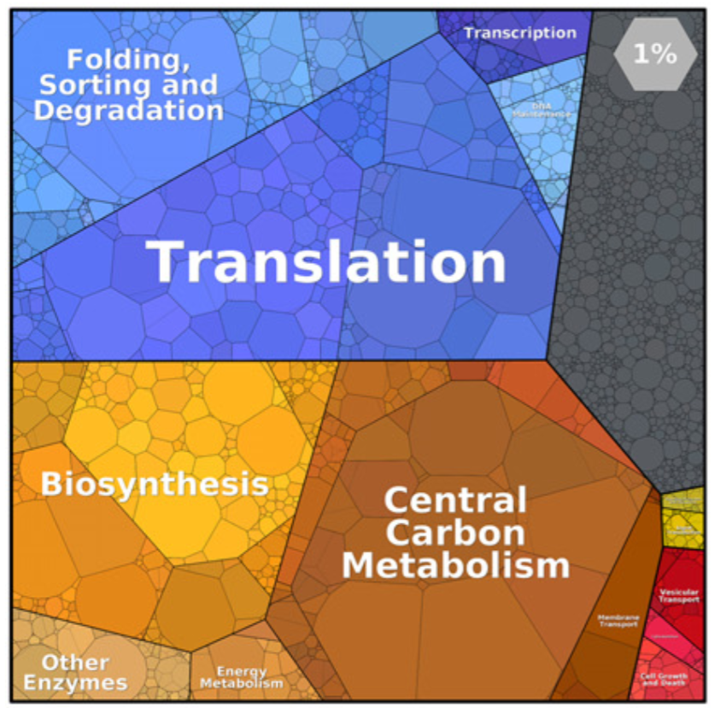
Proteomaps enable quantitative
visualization at the functional level
· Functional clustering
and color code
· Investment in central
dogma is not
homogenous:
Translation >> Transcription
Translation >> Replication
S. Cerevisiae proteome in rich medium
W. Liebermeister et al., 2014.

Slide 36
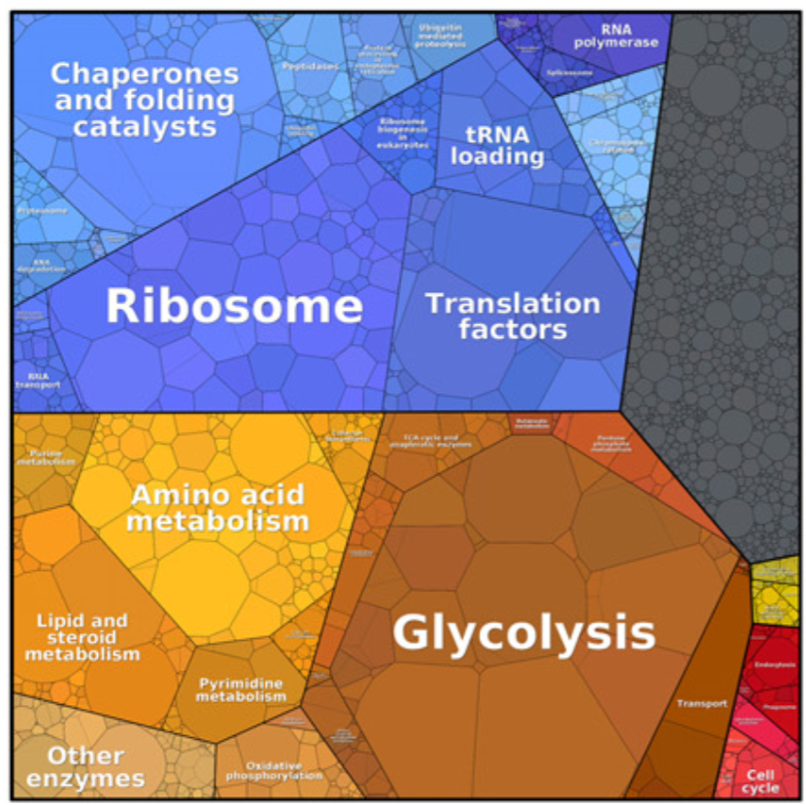
Proteomaps enable quantitative
visualization at the functional level
· Functional clustering
and color code
· Glycolysis >10% of
proteome though
< 1% of genome
S. Cerevisiae proteome in rich medium
W. Liebermeister et al., 2014.

Slide 37
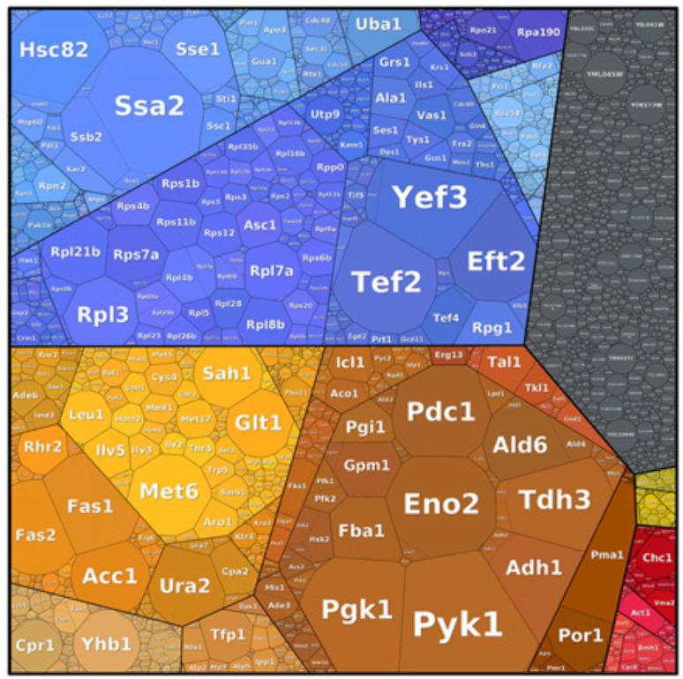
Proteomaps enable quantitative
visualization at the functional level
· Most abundant proteins
are easily recognized
· Our brain are good at extracting information
from images
· Our intuition & memory
Gains from images (rather
than only tables etc.)
S. Cerevisiae proteome in rich medium
W. Liebermeister et al., 2014.

Slide 38
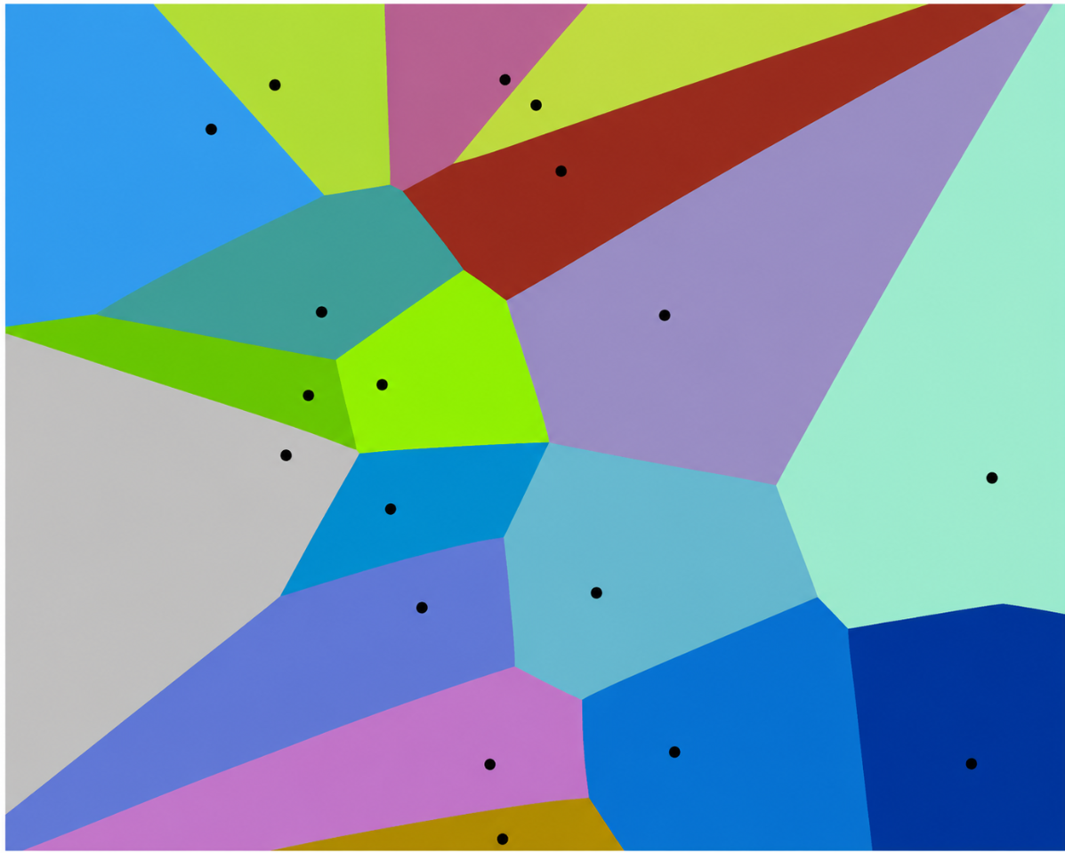
Proteomaps are created
as consecutively refined
Voronoi diagrams
Bernhardt J, Funke S, Hecker M, Siebourg J (2009) in Sixth International Symposium on Voronoi Diagrams, pp. 233-241

Slide 39
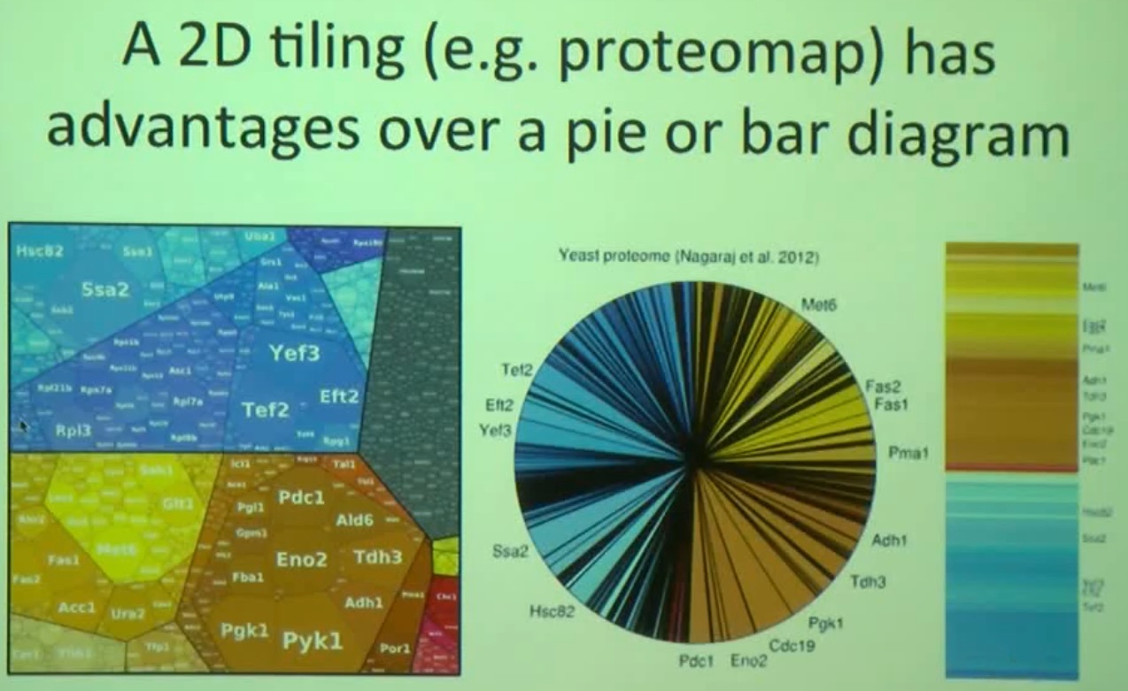
这里的饼图和柱状图需要自己画，我们需要使用这一张slides吗？

Slide 40
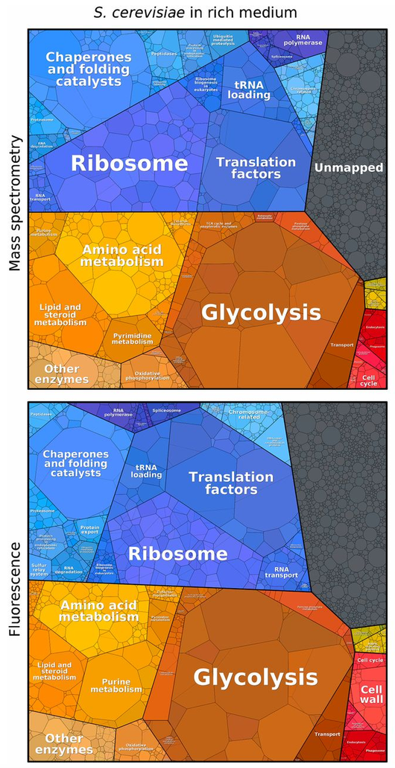
Different measurement
methods give a
consistent picture of
the major cellular
investments
W. Liebermeister et al., 2014.

Slide 41
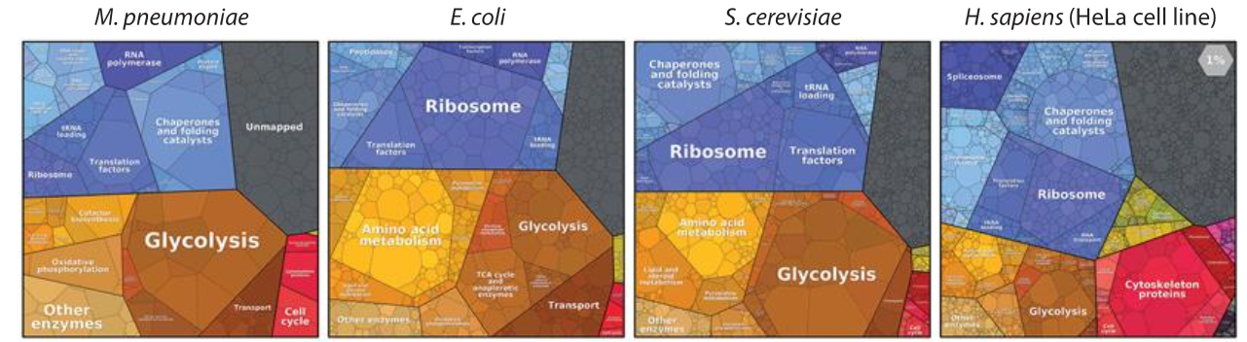
Comparative view of the proteome: commonalities and species-specific trends
Source: Cell Biology by the Numbers (July 2015), p. 148, Fig. 2.

Slide 42
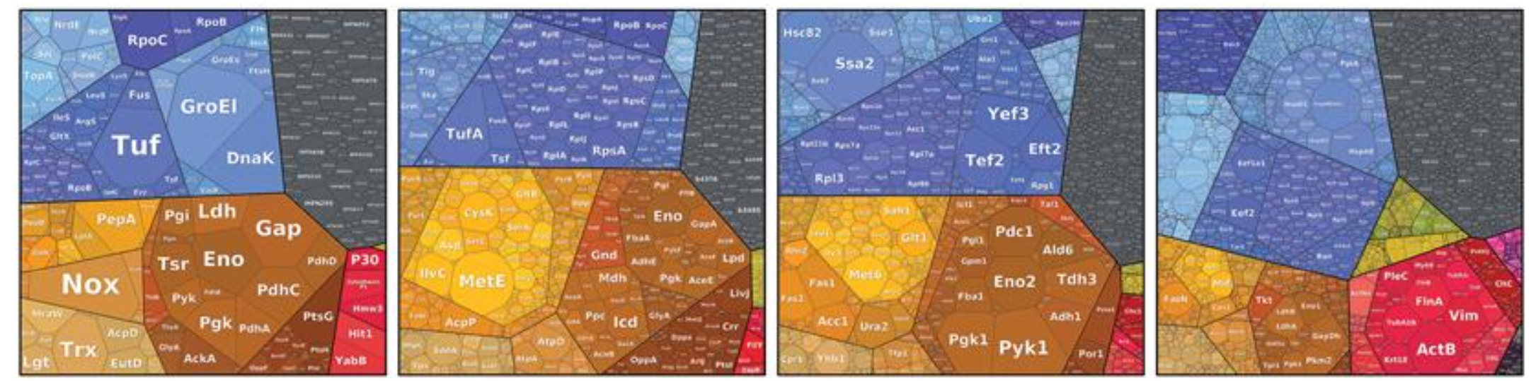
Top proteins abundance and function
· Highest expressing protein usually 3-5% of proteome
· Usually 10-20 proteins >1% of proteome each
· Common top 10 stars: Glycolytic (Eno, Gap, Pgk, Pyk),
Elongation factors (Tuf/Yef), Chaperones (GroEL, DnaK)
Source: Cell Biology by the Numbers (July 2015), p. 148, Fig. 2.

Slide 43
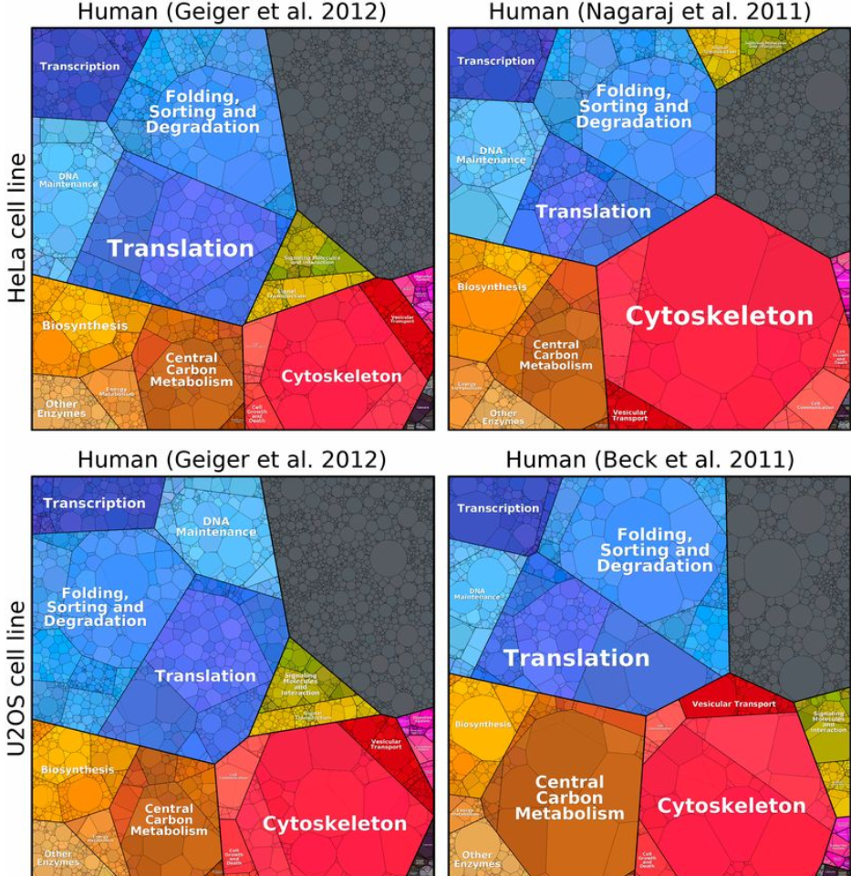
How similar are different cell lines?
W. Liebermeister et al., 2014.

Slide 44
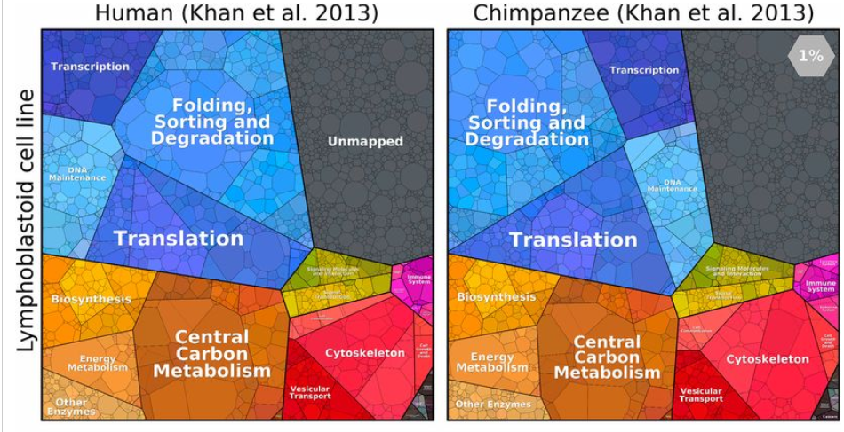
How similar are we to a chimp?
W. Liebermeister et al., 2014.

Slide 45
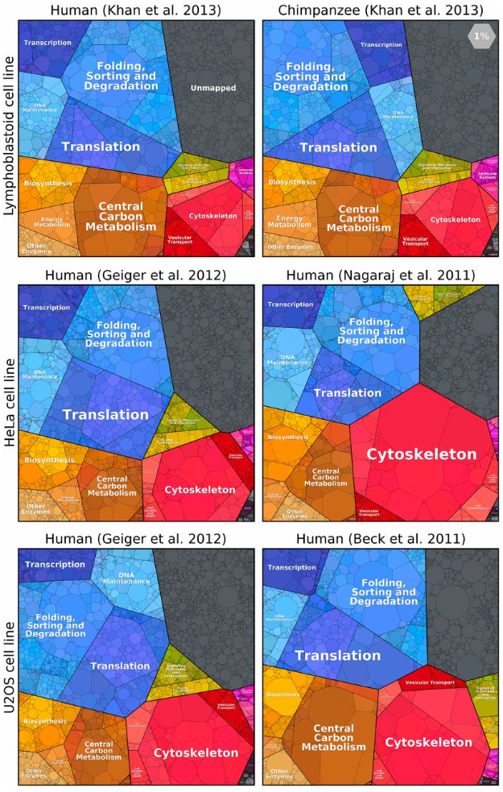
How different is a
human cell line
from other human
cell lines and from
the same cell line
in chimp?
W. Liebermeister et al., 2014.

Slide 46
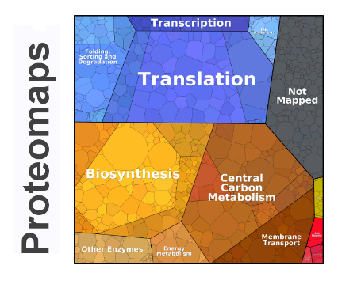
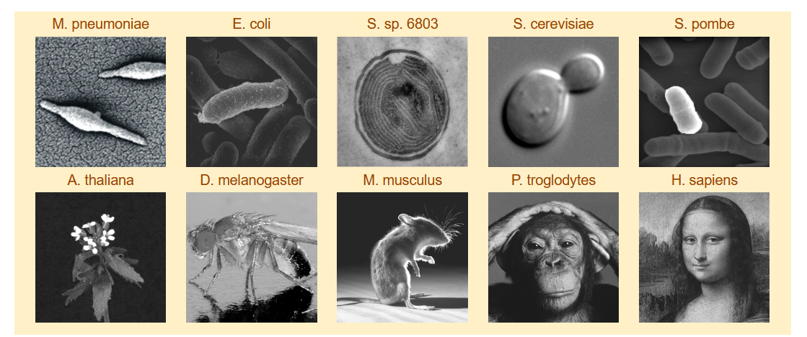
https://www.proteomaps.net
Depicting the protein composition of cells
Proteomaps show the quantitative composition of proteomes with a focus on protein function. They are built automatically from proteome data and based on the KEGG Pathways gene classification. Each protein is shown by a polygon and functionally related proteins are arranged in common regions. To emphasize highly expressed proteins, polygon areas represent protein abundances, weighted by protein size.

